Slide 1
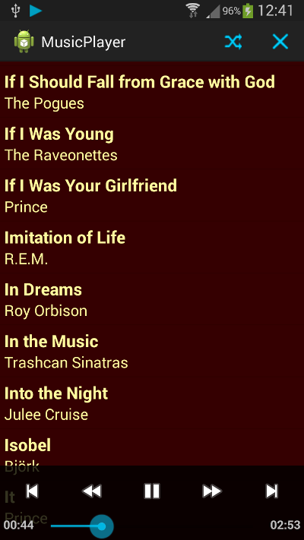
Jonathan Westerfield, Music Man
Summary: The purpose of this app is to play music
Features:
Will list all of the music files we can play
Can pause, play, skip and replay songs
Will display the album art if the song has it
User can create playlist of songs
Will either pull from Spotify API or have its own music library in the resource files
Activities:
Activity 1: The main activity will simply be a listview of all the songs that can be played along with the artist of the song in the same listview element
Activity 2: This will be a new activity that switches to the music player portion of the app where it displays the song artist, album, genre and cover art
Dynamic UI Elements
Fragment 1: The pause/play, skip, and forward buttons will be present on the main listview activity if the phone is turned horizontal
Fragment 2: When turned horizontal, the music player will display the previous song and the next song to be played.

